Slide 1
Data Mining: Data Dr. Lov Kumar Assistant Professor, BITS Pilani, Hyderabad Campus

Slide 2
What is Data?
Collection of data objects and their attributes
An attribute is a property or characteristic of an object
Examples: eye color of a person, temperature, etc.
Attribute is also known as variable, field, characteristic, or feature
A collection of attributes describe an object
Object is also known as record, point, case, sample, entity, or instance
Attributes
Objects

Slide 3
Attribute Values
Attribute values are numbers or symbols assigned to an attribute
Distinction between attributes and attribute values
Same attribute can be mapped to different attribute values
Example: height can be measured in feet or meters
Different attributes can be mapped to the same set of values
Example: Attribute values for ID and age are integers
But properties of attribute values can be different
ID has no limit but age has a maximum and minimum value

Slide 4
Types of Attributes
There are different types of attributes
Nominal: Data are neither measured nor ordered but subjects are merely allocated to distinct categories
Examples: ID numbers, eye color, zip codes
Ordinal: Ordinal data is a categorical where the variables have natural, ordered categories and the distances between the categories is not known.
Examples: rankings (e.g., taste of potato chips on a scale from 1-10), grades, height in {tall, medium, short}
Interval: In interval measurement the distance between attributes does have meaning.
Examples: calendar dates, temperatures in Celsius or Fahrenheit.
Ratio:
Examples: temperature in Kelvin, length, time, counts

Slide 5
The type of an attribute depends on which of the following properties it possesses:
Distinctness: = ≠
Order: < >
Addition: + -
Multiplication: * /
Nominal attribute: distinctness
Ordinal attribute: distinctness & order
Interval attribute: distinctness, order & addition
Ratio attribute: all 4 properties

Slide 6
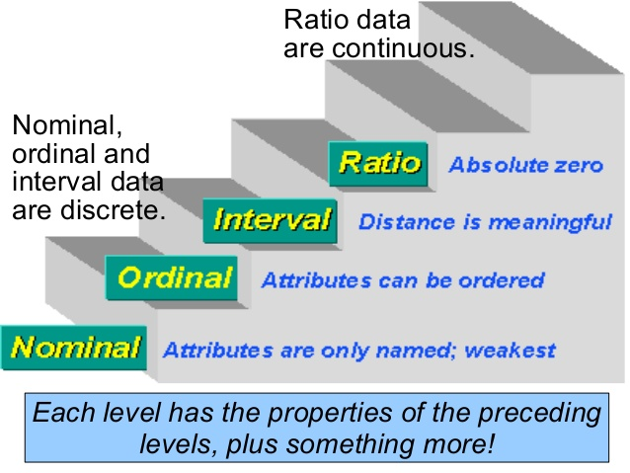

Slide 7
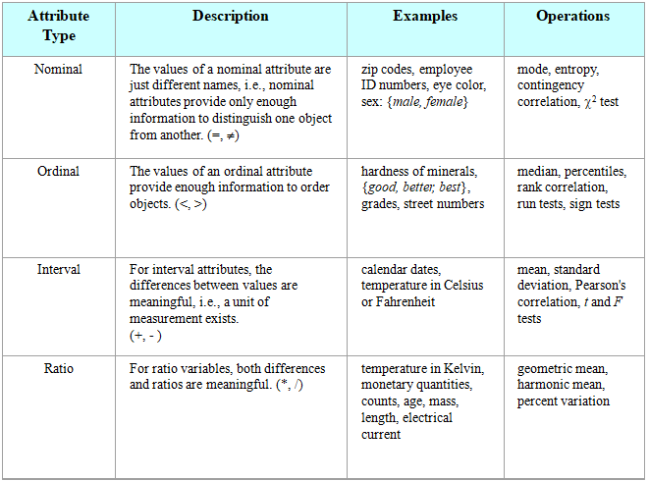

Slide 8
Discrete and Continuous Attributes
Discrete Attribute
Has only a finite or countable infinite set of values
Examples: zip codes, counts, or the set of words in a collection of documents
Often represented as integer variables.
Note: binary attributes are a special case of discrete attributes
Continuous Attribute
Has real numbers as attribute values
Examples: temperature, height, or weight.
Practically, real values can only be measured and represented using a finite number of digits.
Continuous attributes are typically represented as floating-point variables.

Slide 9
Types of data sets
Record
Data Matrix
Document Data
Transaction Data
Graph
World Wide Web
Molecular Structures
Ordered
Spatial Data
Temporal Data
Sequential Data
Genetic Sequence Data

Slide 10
Record Data
Data that consists of a collection of records, each of which consists of a fixed set of attributes.

Slide 11
Data Matrix
If data objects have the same fixed set of numeric attributes, then the data objects can be thought of as points in a multi-dimensional space, where each dimension represents a distinct attribute
Such data set can be represented by an m by n matrix, where there are m rows, one for each object, and n columns, one for each attribute

Slide 12
Document Data
Each document becomes a `term' vector,
each term is a component (attribute) of the vector,
the value of each component is the number of times the corresponding term occurs in the document.

Slide 13
Transaction Data
A special type of record data, where
each record (transaction) involves a set of items.
For example, consider a grocery store. The set of products purchased by a customer during one shopping trip constitute a transaction, while the individual products that were purchased are the items.

Slide 14
Graph Data

Slide 15
Molecular Structures : Chemical Data

Slide 16
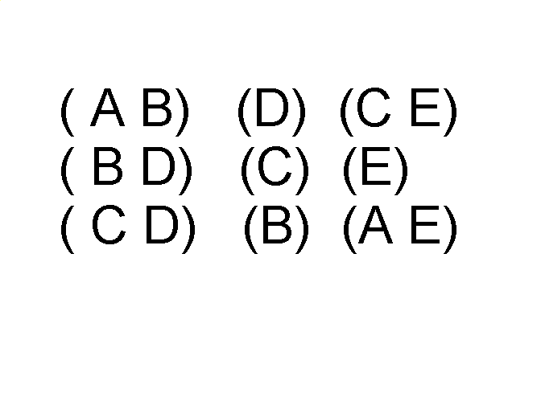
Ordered Data
Sequences of transactions
An element of the sequence

Slide 17
Data Quality
What kinds of data quality problems?
How can we detect problems with the data?
What can we do about these problems?
Examples of data quality problems:
Noise and outliers
missing values
duplicate data

Slide 18
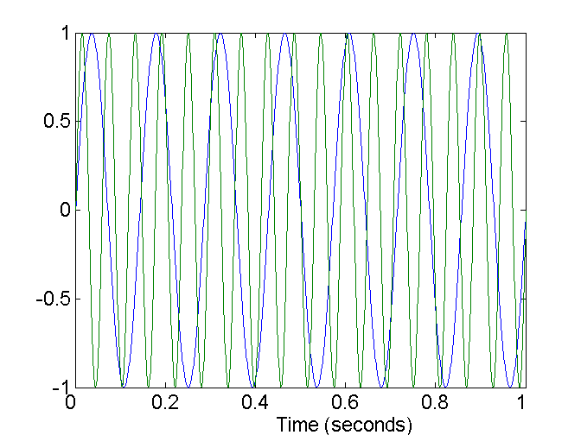
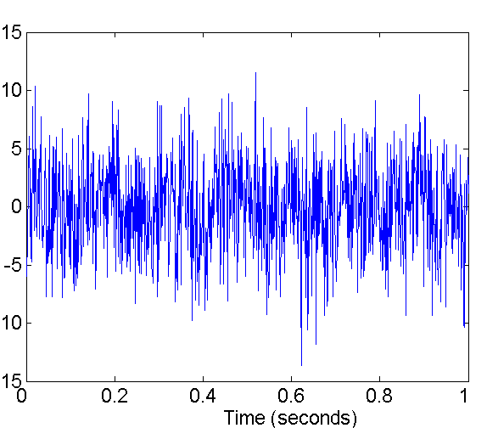
Noise
Noise refers to modification of original values
Examples: distortion of a person’s voice when talking on a poor phone and “snow” on television screen
Two Sine Waves
Two Sine Waves + Noise

Slide 19
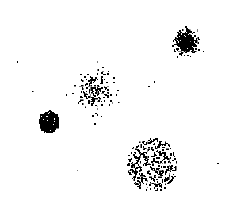
Outliers are data objects with characteristics that are considerably different than most of the other data objects in the data set

Slide 20
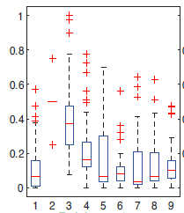


Effectiveness of outliers is examined by using the following equation:
Standard deviation(σ): how much the members of a group differ from the mean value for the group=

Slide 21
Missing Values
Reasons for missing values
Information is not collected (e.g., people decline to give their age and weight)
Attributes may not be applicable to all cases (e.g., annual income is not applicable to children)
Handling missing values
Eliminate Data Objects
Estimate Missing Values
Ignore the Missing Value During Analysis
Replace with all possible values (weighted by their probabilities)

Slide 22
Duplicate Data
Data set may include data objects that are duplicates, or almost duplicates of one another
Examples:
Same person with multiple email addresses
Data cleaning
Process of dealing with duplicate data issues

Slide 23
Data Preprocessing
Aggregation
Sampling
Dimensionality Reduction
Feature subset selection
Feature creation
Discretization and Binarization
Attribute Transformation

Slide 24
Aggregation
Combining two or more attributes (or objects) into a single attribute (or object)
Purpose
Data reduction
Reduce the number of attributes or objects
Change of scale
Cities aggregated into regions, states, countries, etc

Slide 25
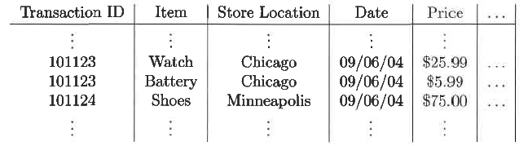
Reducing the possible values for date from 365 days to 12 months.
This type of aggregation is commonly used in Online Analytical Processing (OLAP).

Slide 26

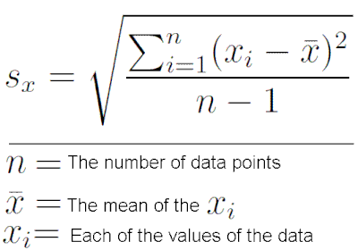
Arithmetic mean:
Standard deviation: how much the members of a group differ from the mean value for the group.

Slide 27
Sampling
Sampling is the main technique employed for data selection.
It is often used for both the preliminary investigation of the data and the final data analysis.
Sampling is used in data mining because processing the entire set of data of interest is too expensive or time consuming.

Slide 28
Types of Sampling
Simple Random Sampling
There is an equal probability of selecting any particular item.
Sampling without replacement
As each item is selected, it is removed from the population.
Sampling with replacement
Objects are not removed from the population as they are selected for the sample.
In sampling with replacement, the same object can be picked up more than once
Stratified sampling
Split the data into several partitions; then draw random samples from each partition

Slide 29

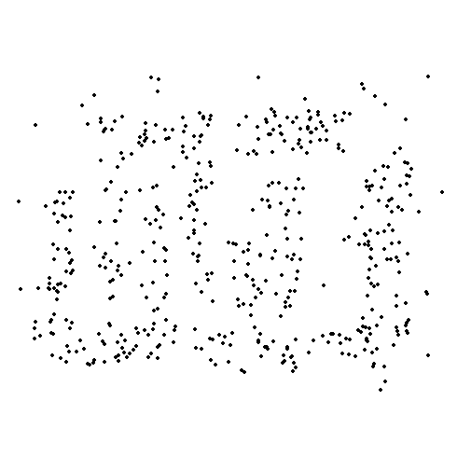
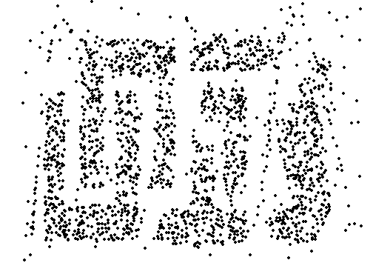
8000 points 2000 Points 500 Points

Slide 30
Dimensionality Reduction
Purpose:
Avoid curse of dimensionality
Reduce amount of time and memory required by data mining algorithms
Allow data to be more easily visualized
May help to eliminate irrelevant features or reduce noise
Techniques:
Principle Component Analysis
Others: supervised and non-linear techniques

Slide 31
Feature Subset Selection
Redundant features
duplicate much or all of the information contained in one or more other attributes
Example: purchase price of a product and the amount of sales tax paid
Irrelevant features
contain no information that is useful for the data mining task at hand
Example: students' ID is often irrelevant to the task of predicting students' GPA

Slide 32
Techniques:
Brute-force approaches:
Try all possible feature subsets as input to data mining algorithm
Filter approaches:
Features are selected before data mining algorithm is run
Wrapper approaches:
Use the data mining algorithm as a black box to find best subset of attributes

Slide 33
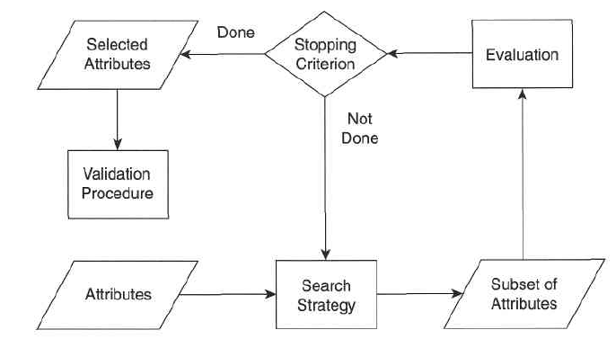
Feature Subset Selection

Slide 34
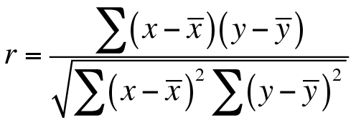
Filter approaches
Pearson’s Correlation: It is used as a measure for quantifying linear dependence between two continuous variables X and Y. Its value varies from -1 to +1. Pearson’s correlation is given as:

Slide 35
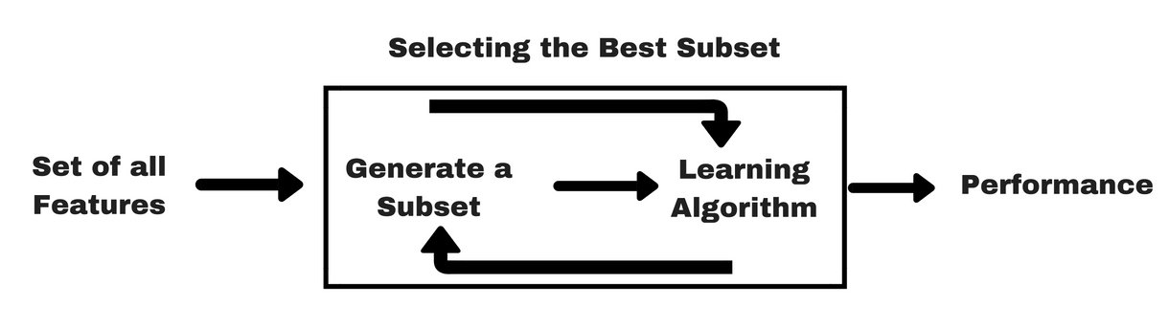
Wrapper approaches
we try to use a subset of features and train a model using them.

Slide 36
Sequential Forward Selection (SFS)
Sequential Forward Selection (SFS)
• Start with the empty set, X=0
• Repeatedly add the most significant feature with respect to X

Slide 37
Feature Creation
Create new attributes that can capture the important information in a data set much more efficiently than the original attributes.
Three general methodologies:
Feature Extraction:
Mapping Data to New Space
Feature Construction

Slide 38
Attribute Transformation
A function that maps the entire set of values of a given attribute to a new set of replacement values such that each old value can be identified with one of the new values
Simple functions: x^{k}, log(x), e^{x}, |x|
Standardization and Normalization

Slide 39
Similarity and Dissimilarity
Similarity
Numerical measure of how alike two data objects are.
Is higher when objects are more alike.
Often falls in the range [0,1]
Dissimilarity
Numerical measure of how different are two data objects
Lower when objects are more alike
Minimum dissimilarity is often 0
Upper limit varies

Slide 40
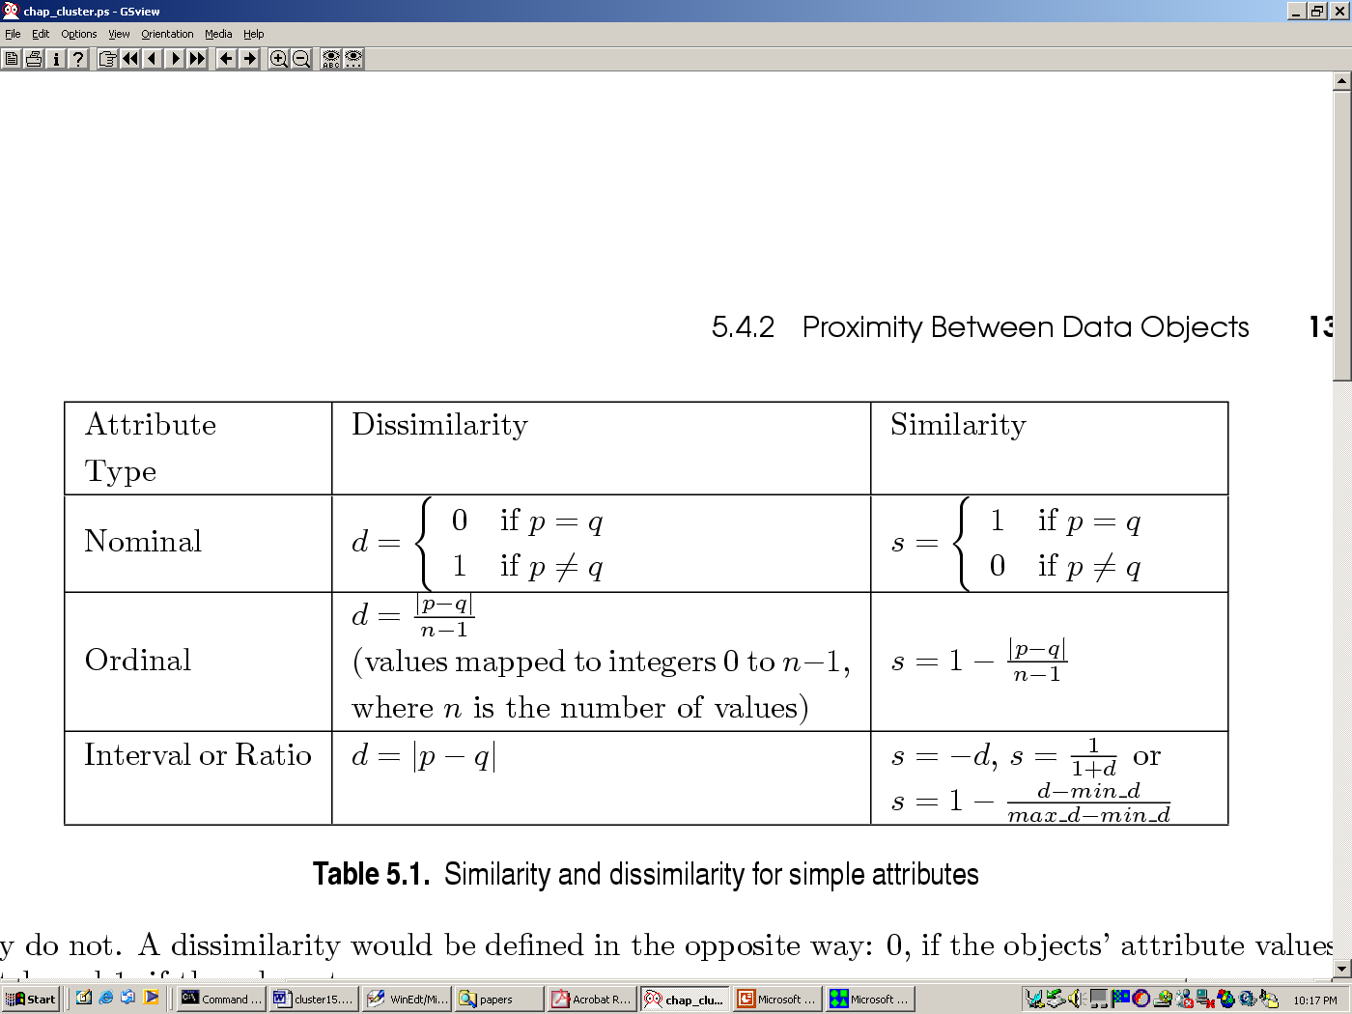
Similarity/Dissimilarity for Simple Attributes

Slide 41
Euclidean Distance
Euclidean Distance
Where n is the number of dimensions (attributes) and p_{k} and q_{k} are, respectively, the k^{th} attributes (components) or data objects p and q.

Slide 42
Euclidean Distance

Slide 43
Common Properties of a Distance
Distances, such as the Euclidean distance, have some well known properties.
d(p, q) ≥ 0 for all p and q and d(p, q) = 0 only if p = q. (Positive definiteness)
d(p, q) = d(q, p) for all p and q. (Symmetry)
d(p, r) ≤ d(p, q) + d(q, r) for all points p, q, and r. (Triangle Inequality)
where d(p, q) is the distance (dissimilarity) between points (data objects), p and q.
Measures that satisfy all three properties are known as metrics.

Slide 44
Non-metric Dissimilarities:
A: { I ,2,3,4} and B : {2,3,4}
A- B: {1}
B - A : φ
d(A,B): size(A- B) + size(B - A)
where size is a function returning the number of elements in a set

Slide 45
Common Properties of a Similarity
Similarities, also have some well known properties.
s(p, q) = 1 (or maximum similarity) only if p = q.
s(p, q) = s(q, p) for all p and q. (Symmetry)
where s(p, q) is the similarity between points (data objects), p and q.

Slide 46
Similarity Between Binary Vectors
Common situation is that objects, p and q, have only binary attributes
Compute similarities using the following quantities
M₀₁ = the number of attributes where p was 0 and q was 1
M₁₀ = the number of attributes where p was 1 and q was 0
M₀₀ = the number of attributes where p was 0 and q was 0
M₁₁ = the number of attributes where p was 1 and q was 1
Simple Matching and Jaccard Coefficients
SMC = number of matches / number of attributes
= (M₁₁ + M₀₀) / (M₀₁ + M₁₀ + M₁₁ + M₀₀)
J = number of 11 matches / number of not-both-zero attributes values
= (M₁₁) / (M₀₁ + M₁₀ + M₁₁)

Slide 47
SMC versus Jaccard: Example
p = 1 0 0 0 0 0 0 0 0 0
q = 0 0 0 0 0 0 1 0 0 1
M₀₁ = 2 (the number of attributes where p was 0 and q was 1)
M₁₀ = 1 (the number of attributes where p was 1 and q was 0)
M₀₀ = 7 (the number of attributes where p was 0 and q was 0)
M₁₁ = 0 (the number of attributes where p was 1 and q was 1)
SMC = (M₁₁ + M₀₀)/(M₀₁ + M₁₀ + M₁₁ + M₀₀) = (0+7) / (2+1+0+7) = 0.7
J = (M₁₁) / (M₀₁ + M₁₀ + M₁₁) = 0 / (2 + 1 + 0) = 0

Slide 48
Cosine Similarity
If d₁ and d₂ are two document vectors, then
cos( d₁, d₂ ) = (d₁ • d₂) / ||d₁|| ||d₂|| ,
where • indicates vector dot product and || d || is the length of vector d.
Example:
d₁ = 3 2 0 5 0 0 0 2 0 0
d₂ = 1 0 0 0 0 0 0 1 0 2
d₁ • d₂= 3*1 + 2*0 + 0*0 + 5*0 + 0*0 + 0*0 + 0*0 + 2*1 + 0*0 + 0*2 = 5
||d₁|| = (3*3+2*2+0*0+5*5+0*0+0*0+0*0+2*2+0*0+0*0)^{0.5} = (42) ^{0.5} = 6.481
||d₂|| = (1*1+0*0+0*0+0*0+0*0+0*0+0*0+1*1+0*0+2*2) ^{0.5} = (6) ^{0.5} = 2.245
cos( d₁, d₂ ) = .3150

Slide 49
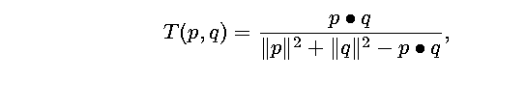
Extended Jaccard Coefficient
The extended Jaccard coefficient can be used for document data.

Slide 50
Pearson's Correlation
Correlation measures the linear relationship between objects
To compute correlation, we standardize data objects, p and q, and then take their dot product

Slide 51


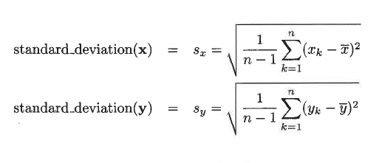

Slide 52
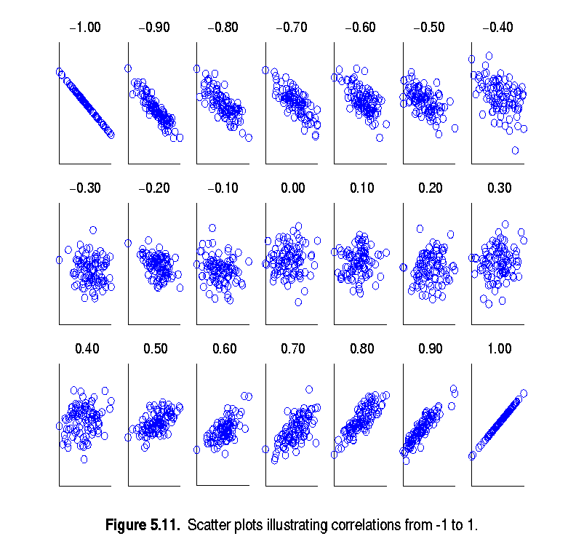
Visually Evaluating Correlation

Slide 53
Perfect Correlation.
Correlation is always in the range -1 to 1.
A correlation of 1 (-1) means that x and y have a perfect positive (negative) linear relationship.
x: (-3, 6, 0, 3, -6)
y: ( 1, -2, 0,-7, 2 )
x: ( 3 , 6 , 0 , 3 , 6 )
y : ( 1 , 2 , 0 , 1 , 2)

Slide 54
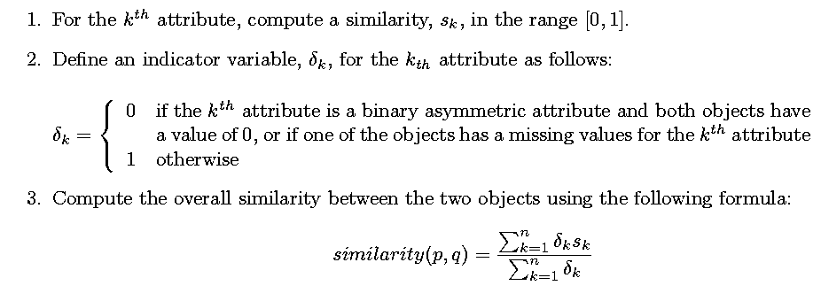
General Approach for Combining Similarities
Sometimes attributes are of many different types, but an overall similarity is needed.

Slide 55

Using Weights to Combine Similarities
May not want to treat all attributes the same.
Use weights w_{k} which are between 0 and 1 and sum to 1.

